Slide 1

EXECUTIVE REPORT
Customer Churn Analysis & Predictive Modeling Strategy
A comprehensive analysis of 10,000 customers revealing critical risk factors and a proactive retention system capable of capturing 78% of at-risk customers before they leave.

Slide 2
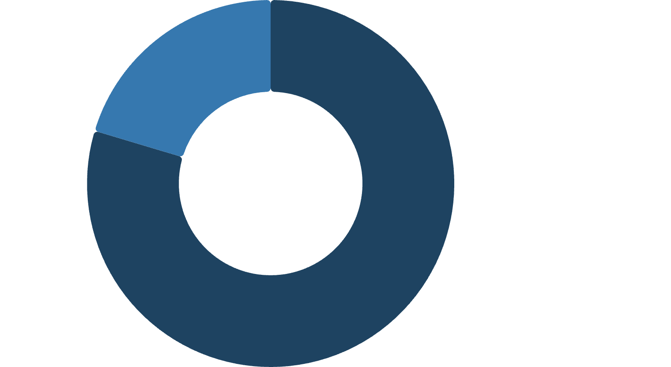


CHAPTER 1
Executive Summary
Our current churn rate stands at 20.37%. Through exploratory data analysis and an optimized LightGBM predictive model, we've identified critical risk factors and built a proactive retention system.
Retained·79.63%
·79.63%
·
Churned·20.37%
·20.37%
·
10K
20.37%
78%
Customers Analyzed
Churn Rate
At-Risk Capture Rate

Slide 3
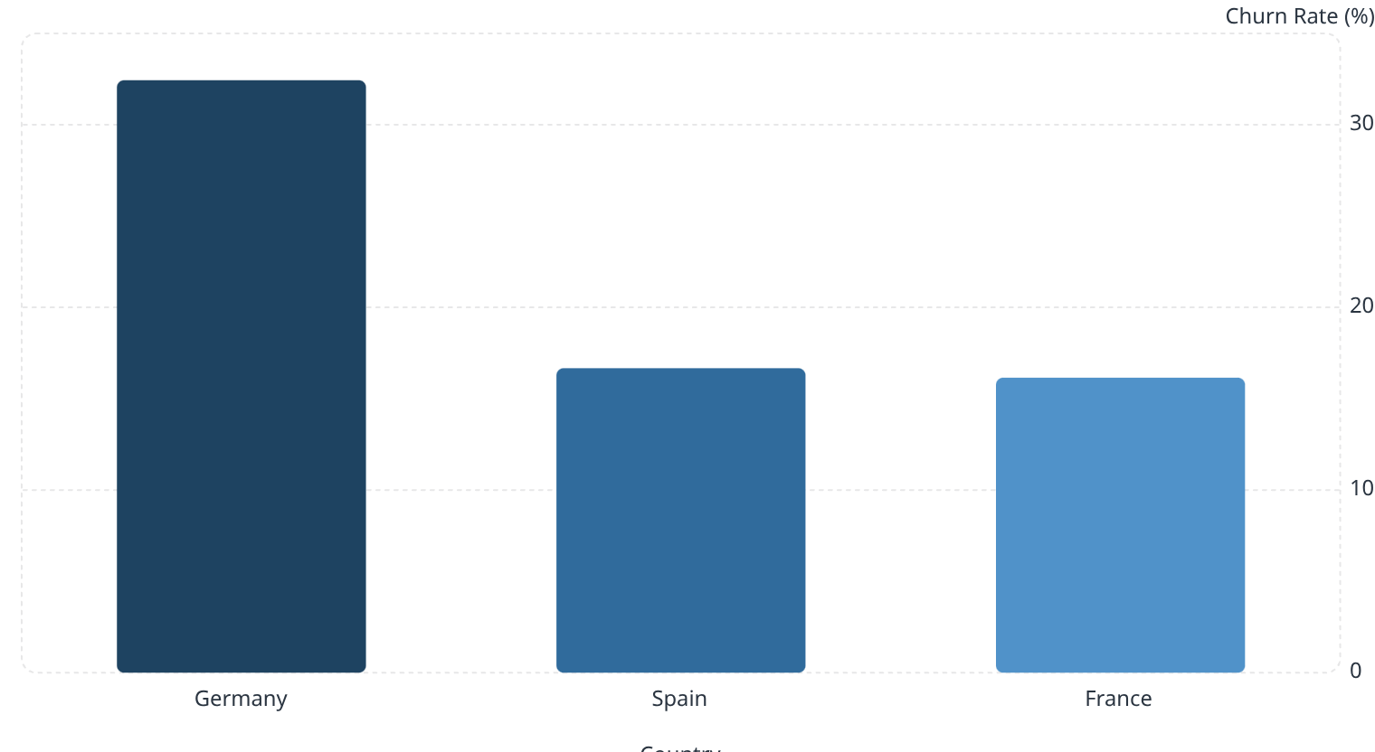

CHAPTER 2 — KEY BUSINESS INSIGHTS
Geographic & Demographic Risk Hotspots
Germany Crisis
Germany's churn rate of 32.44% is more than double France (16.15%) and Spain (16.67%). German customers maintain the highest average balances (~$119,730).
Inactive members churn at 26.85% vs. 14.27% for active members.

Slide 4
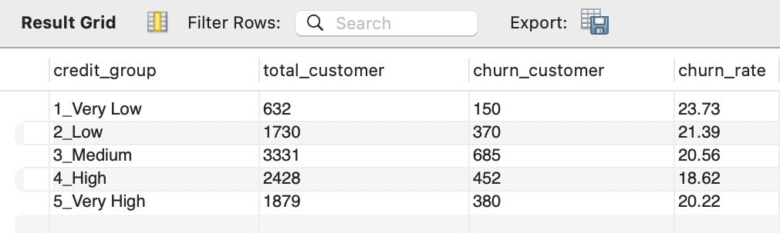
CHAPTER 2 — KEY BUSINESS INSIGHTS
Credit Health & Engagement
Key Findings
Inactive members are nearly twice as likely to churn as active members
Customers with 'Very Low' credit scores show the highest attrition at 23.73%
Engagement level is a stronger predictor of churn than credit score alone

Slide 5

CHAPTER 2 — KEY BUSINESS INSIGHTS
Product & Balance Anomalies
The 'Product 2' Sweet Spot
Multi-Product Paradox
100% of customers with 4 products have left — a critical service failure.
Customers with exactly 2 products are the most loyal — only 7.58% churn rate.
Balance Sensitivity
High-balance customers show elevated churn (23.68%–26.28%), signaling high-value segment volatility.

Slide 6
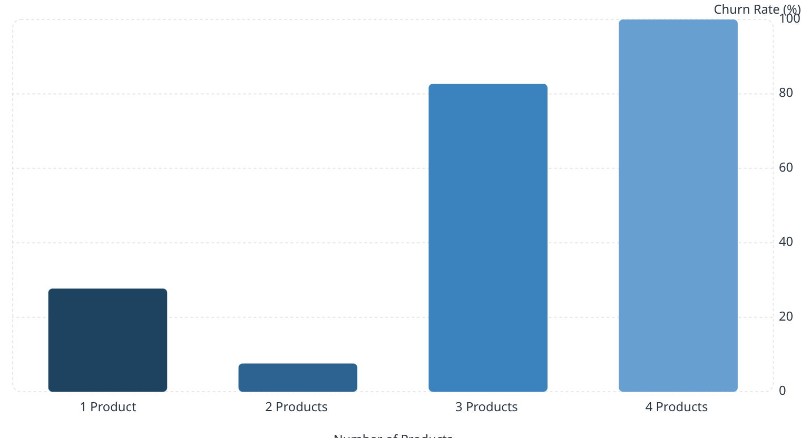
CHAPTER 2 — KEY BUSINESS INSIGHTS
Product Count vs. Churn Rate
The Paradox Explained
Churn follows a U-shaped curve. Two-product customers are the stickiest, while single-product and multi-product customers represent the highest risk.
Moving single-product customers to two products could dramatically reduce churn.

Slide 7
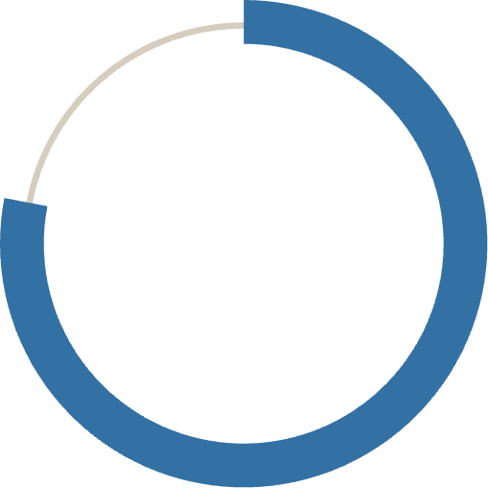
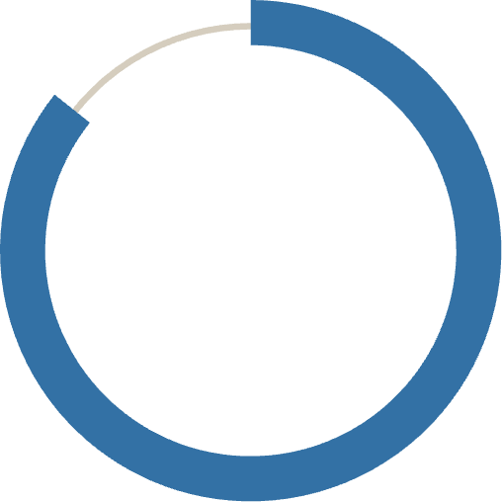
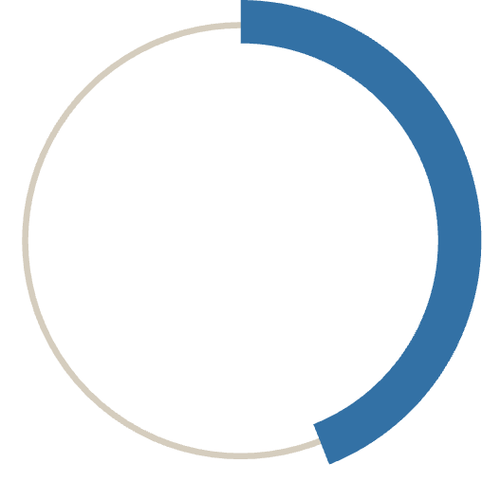
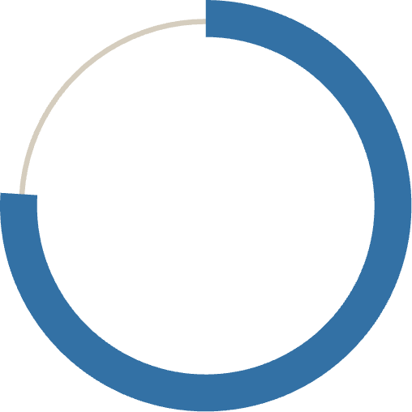
CHAPTER 3 — PREDICTIVE MODELING
LightGBM Model Performance
We deployed an optimized LightGBM model, prioritizing Recall to maximize capture of at-risk revenue.
78%
85.7%
Recall
ROC-AUC
Captures 78% of actual churners
Strong ranking ability
44%
76%
Precision
Accuracy
44% of flagged customers are real churners
Balanced trade-off favoring Recall
In banking, Customer Acquisition Cost (CAC) far exceeds the cost of a false positive retention outreach. Achieving 78% Recall ensures the majority of potential losses are proactively flagged.

Slide 8
CHAPTER 4
Strategic Recommendations
1
2
Germany Retention Taskforce
Product Cross-Selling
Conduct localized analysis and competitive reviews to address the 32.44% churn crisis.
Move single-product customers toward two-product status to hit the 7.58% loyalty sweet spot.
3
4
Re-engage Inactive Members
Early Warning System
Launch automated win-back campaigns targeting the 26.85% inactive churn segment.
Route at-risk leads to Customer Success with retention incentives — fee waivers, loyalty rewards.

Slide 9
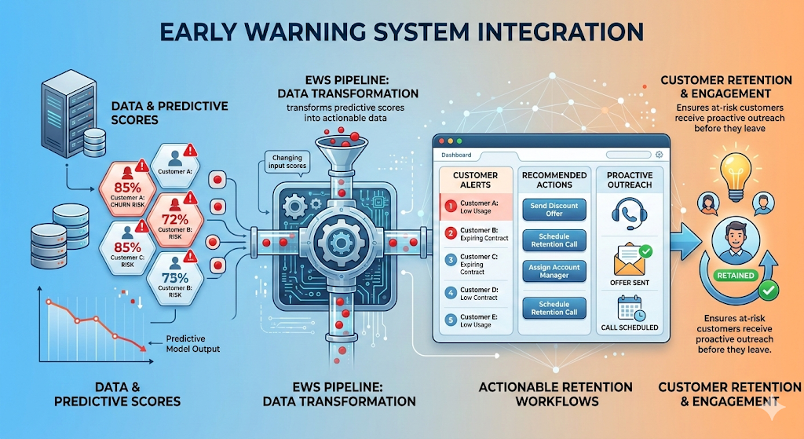
Early Warning System Integration
The EWS pipeline transforms predictive scores into actionable retention workflows, ensuring at-risk customers receive proactive outreach before they leave.

Slide 10

CHAPTER 5
Conclusion
The optimized LightGBM model provides a robust defensive tool. Although churn is currently 20.37%, the ability to predict nearly 4 out of 5 churners enables a proactive, data-driven strategy focused on capital preservation and long-term customer loyalty.
20.37%
78%
Current churn rate
At-risk customers captured
Data-Driven
Proactive retention strategy

